Slide 1
Black Friday Sales Report
Last updated by Nasir Khan
June 21, 22

Slide 2
Introduction
Black Friday is an informal name for the Friday following Thanksgiving Day in the United States, which is celebrated on the fourth Thursday of November. The day after Thanksgiving has been regarded as the beginning of the United States Christmas shopping season since 1952, although the term "Black Friday" did not become widely used until more recent decades. Many stores offer highly promoted sales on Black Friday and open very early, such as at midnight, or may even start their sales at some time on Thanksgiving. The major challenge for a Retail store or eCommerce business is to choose product price such that they get maximum profit at the end of the sales. Our project deals with determining the product prices based on the historical retail store sales data. After generating the predictions, our model will help the retail store to decide the price of the products to earn more profits.

Slide 3
Dataset Description
The dataset is acquired from Kaggle. The data contained features like age, gender, marital status, Occupation, Product Categories & purchased, etc. The data consists of 12 columns and 550068 records.

Slide 4
Exploratory Data Analysis

Slide 5
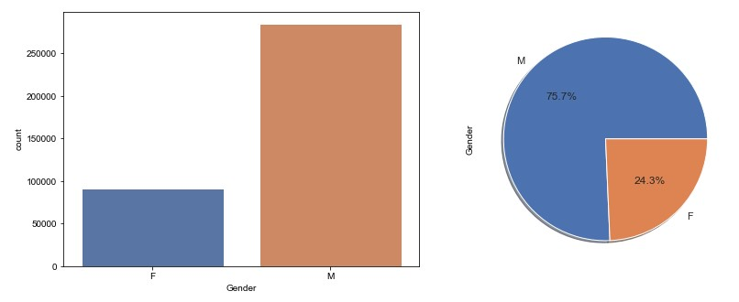
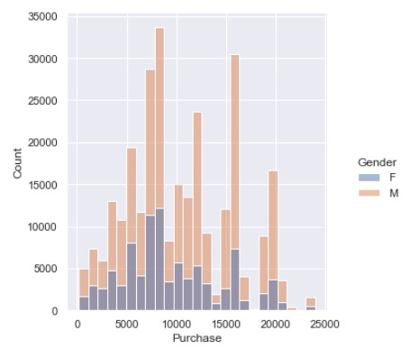
Sale by Gender
As we can clearly see that, there are more no. of males purchasing than females

Slide 6
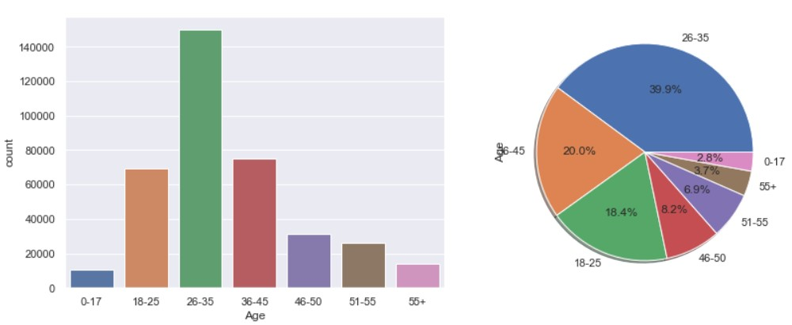
Sale by Age
As we can clearly see that, the customers in age group of 26-35 years are purchasing the most(39.9%), whereas, age group of 0-17 contributing to only 2.8% of all the Black Friday Sales items purchased

Slide 7
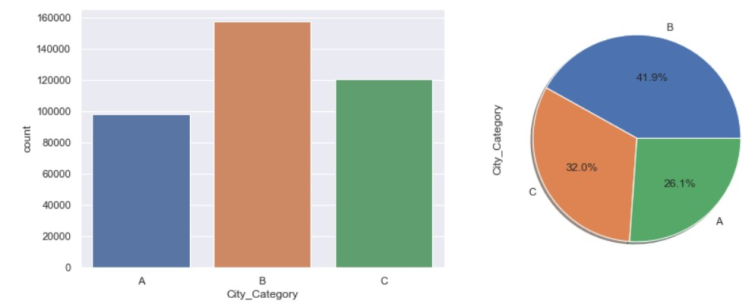
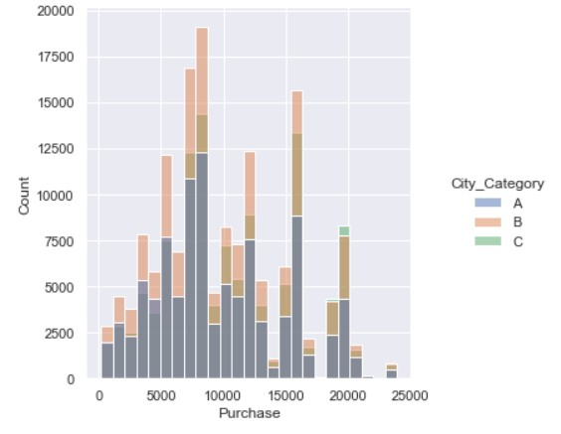
Sale by City Category
As we can clearly see that, the customers of city of category 'B' are purchasing the most nearly(42%), whereas the people from City category A are least interested in purchasing from Black Friday Sales.

Slide 8
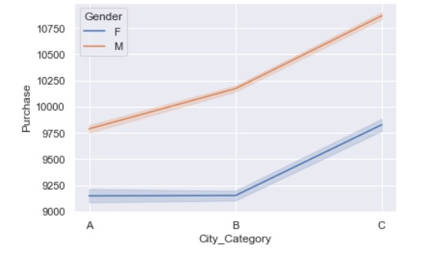
As we can clearly see that the 'Male' and 'Female' customers are purchasing the most in City Category 'C' whereas the Female are least interested in purchasing in City Category 'B' and males from City Category 'A' have shown least interest of purchase.

Slide 9
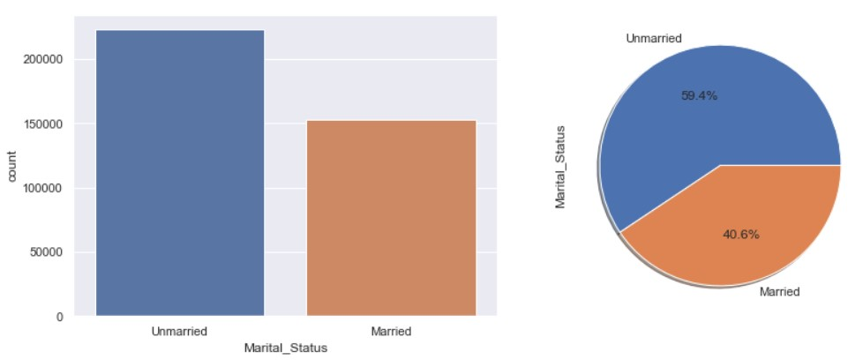
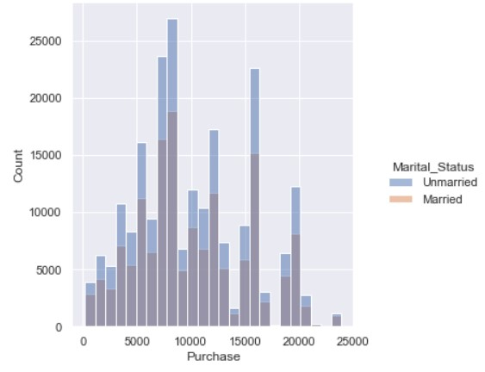
Sale by Marital Status
As we can clearly see that the 'Unmarried' customers are purchasing the most 59.4% whereas the 'Married' are least purchasing around 40.6%.

Slide 10
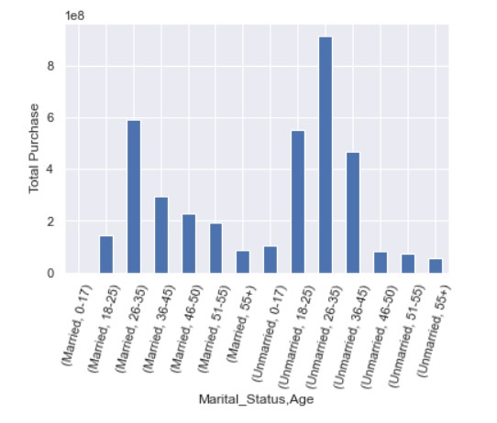
Correlation between Marital Status & Age
Most purchase done is from the age group of 26-35 and unmarried , whereas least purchase from unmarried with 55+ age

Slide 11
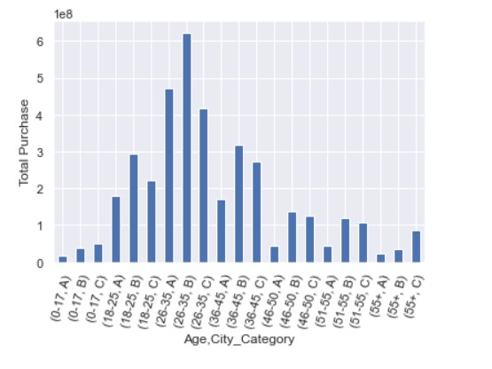
Correlation between Age & City Category
Most purchase done is from the age group of 26-35 from City Category ‘B' , whereas least purchase from the age group of 0-17 and 55+ from City Category 'A'

Slide 12
Conclusion
People from City Category ‘B’ seems to be well off and financially good as they are in the higher purchasing. But, with Age 55+ from ‘B’ City Category are purchasing the least from Black Friday Sales.
Overall purchase from Category B cities is the highest of all.
People from City Category ‘A’ seems to be financially weaker. Black Friday Sales needs to focus on advertisements and marketing to increase the sales.
Most purchase done from the age group of 26-35 and unmarried , whereas least purchase from unmarried with 55+ age.
Male and female from both married and unmarried status if they belongs to city category B then they would spend more.

